Slide 1
User interface of QGIS
Geomathematics, programming and geoinformatics
2026.02.25.
Ákos Bede-Fazekas

Slide 2

QGIS
publicly available
  free and open-source
  available under multiple operating systems (Windows, macOS, Linux)
  multilingual
developed by an international community
  continuously updated
  extensive support (comprehensive
  documentation, forums, training materials,
  user community)
modular structure, expandable with plugins
implements OGC (Open Geospatial Consortium)
standards

Slide 3
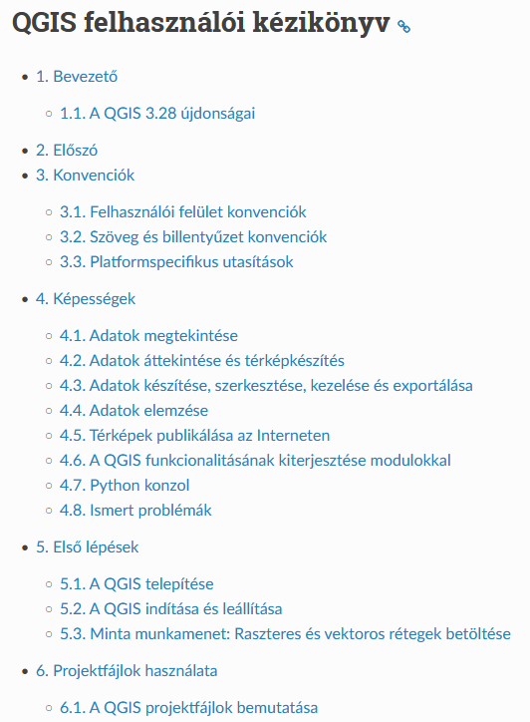
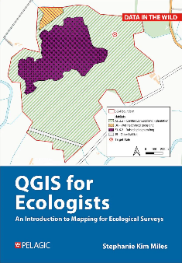
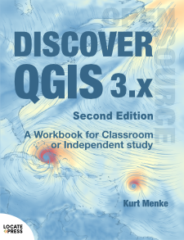
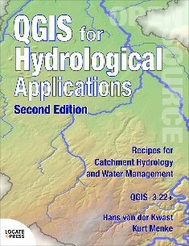
QGIS
numerous books, documentation, and teaching materials are available
  mainly in English, but some in local languages (or mixed)
some useful links
  qgis.org/resources/hub/
  qgis.org/resources/books/
  docs.qgis.org/3.28/hu/docs/gentle_gis_introduction/index.html
  docs.qgis.org/3.28/hu/docs/training_manual/index.html
  docs.qgis.org/3.28/hu/docs/user_manual/index.html
  qgis.org/resources/support/
the material covered in class is sufficient to complete the course

Slide 4
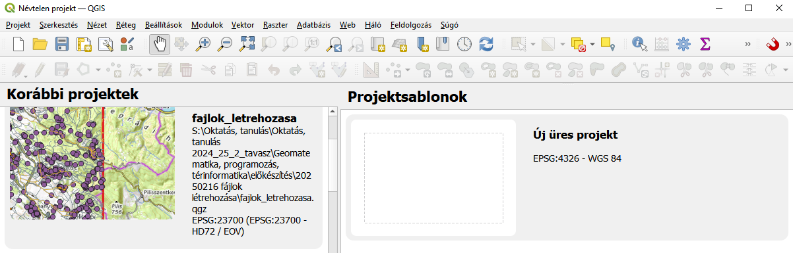
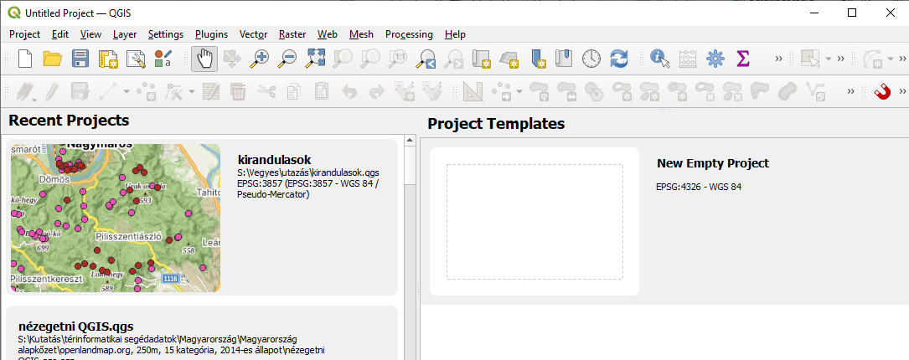
QGIS – create a project
"project"
  we can later add layers to the project
  customize the appearance of the layers (visibility, symbol system, labels)
  create a map layout
  save/load
DEMO
  open QGIS
  create a new project

Slide 5
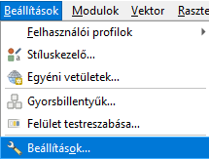
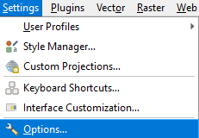


User interface of QGIS
language
  we can change the interface language at any time
  no matter what language we installed it in
we'll use the American English version
Settings > Options… > General > Override System Local > User interface translation
[In Hungarian:] Beállítások > Beállítások… > Általános > Területi és nyelvi beállítás felülbírálása > Felhasználói felület fordítás
requires restarting the program
DEMO
  switch the language to American English

Slide 6
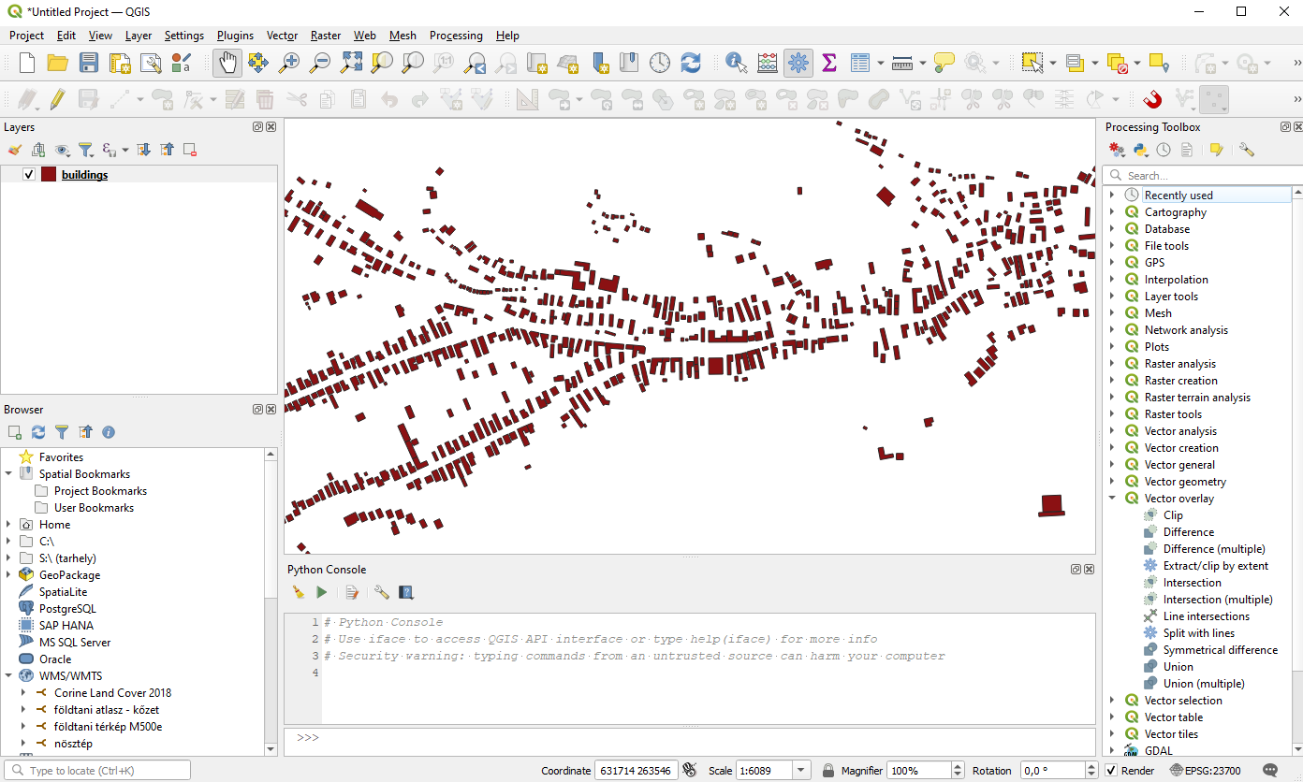
User interface of QGIS
map canvas
layer manager
data source manager (browser)
menu, toolbars
Python console
processing toolbox

Slide 7
User interface of QGIS
map canvas
layer manager
data source manager (browser)
menu, toolbars
Python console
processing toolbox

Slide 8
User interface of QGIS
map canvas
layer manager
data source manager (browser)
menu, toolbars
Python console
processing toolbox

Slide 9
User interface of QGIS
map canvas
layer manager
data source manager (browser)
menu, toolbars
Python console
processing toolbox

Slide 10
User interface of QGIS
map canvas
layer manager
data source manager (browser)
menu, toolbars
Python console
processing toolbox

Slide 11
User interface of QGIS
map canvas
layer manager
data source manager (browser)
menu, toolbars
Python console
processing toolbox

Slide 12
User interface of QGIS
map canvas
layer manager
data source manager (browser)
menu, toolbars
Python console
processing toolbox

Slide 13

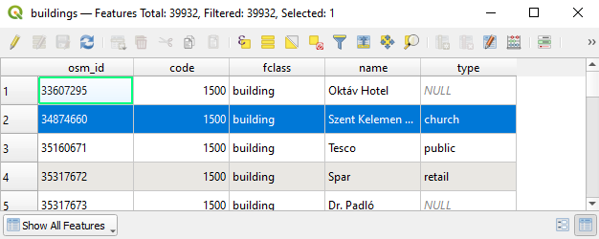
User interface of QGIS
map canvas
layer manager
data source manager (browser)
menu, toolbars
Python console
processing toolbox
attribute table
  in other window
  connected (selections)
  look for it on the tray!

Slide 14
User interface of QGIS
map canvas
layer manager
data source manager (browser)
menu, toolbars
Python console
processing toolbox
attribute table
  in other window
  connected (selections)
  look for it on the tray!

Slide 15
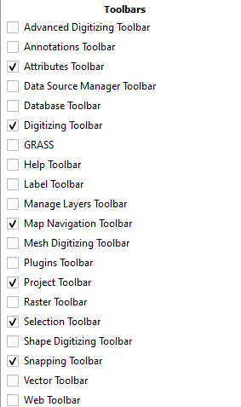
User interface of QGIS
panels and toolbars
  View > Panels
  View > Toolbars
  or right-click on the gray area at the top
Processing > Toolbox
Plugins > Python Console
DEMO
  open, move to the right side, then close the processing toolbox
  open, move to the bottom, then close the Python console
  display these toolbars (and close all the other ones) ►
Notes:
Nézet > Panelek
Nézet > Eszköztárak
Feldolgozás > Eszköztár
Modulok > Python-konzol

Slide 16
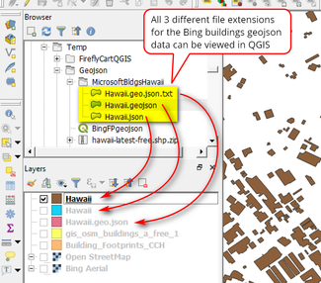
Adding layers
several different types of layers can be added
we'll try the following ones:
  raster
  vector
  vector from non-spatial dataset
  non-spatial dataset (as a simple table)
  online service (base map)

Slide 17
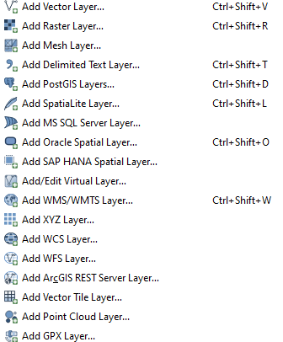
Adding layers
alternative ways
  drag-and-drop from other software (Windows Explorer, Total Commander)
  drag-and-drop from the Browser panel
  right-click on the file at the Browser > Add Layer to Project
  Layer > Add layer > [select a file type]
if we drag-and-drop a multi-layer data source
  we can select the layer(s) in a popup window
Notes:
Böngésző panel jobb klikk a fájlra > Réteg hozzáadása a projekthez
Réteg > Réteg hozzáadása > [itt kiválasztjuk a típust]

Slide 18
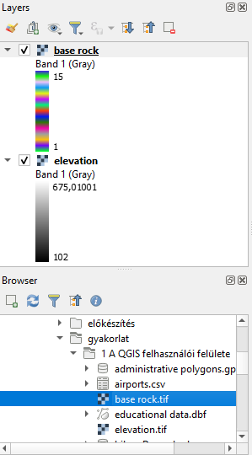
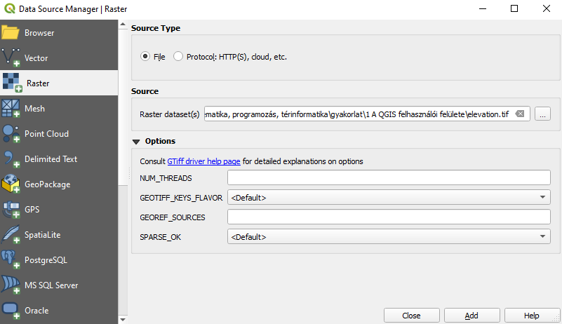
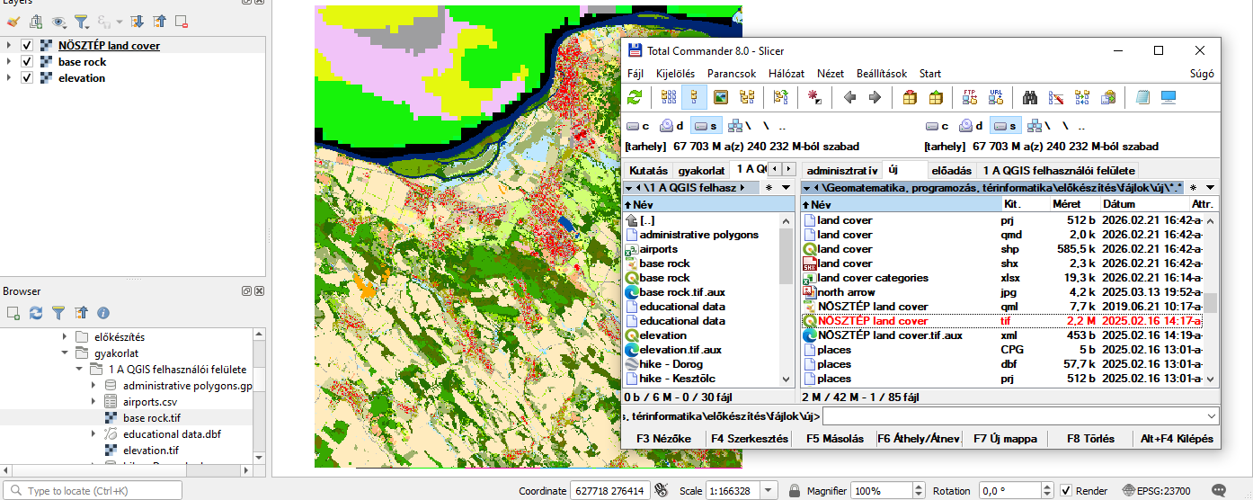
Adding layers – raster
DEMO
  add elevation.tif from the menu (Layer > Add layer)
  drag-and-drop base rock.tif from the Browser panel
  collapse the legend of the layers
  NÖSZTÉP land cover.tif: drag-and-drop from other software (to the map canvas or the layer manager)
2
1
3
Notes:
Réteg > Réteg hozzáadása

Slide 19
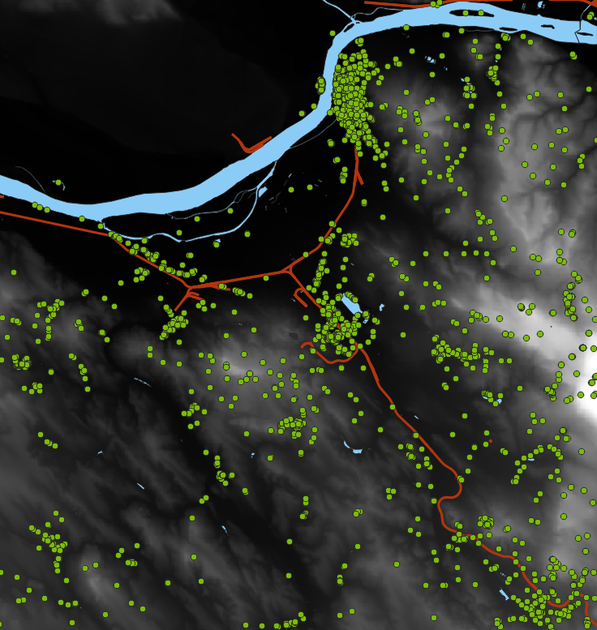
Adding layers – vector
DEMO
  hide the rasters of base rock and NÖSZTÉP land cover
  drag-and-drop the 3 shapefiles (water bodies, railways, points of interest)
  the .shp file should be dragged (the other ones are auxiliary files)

Slide 20
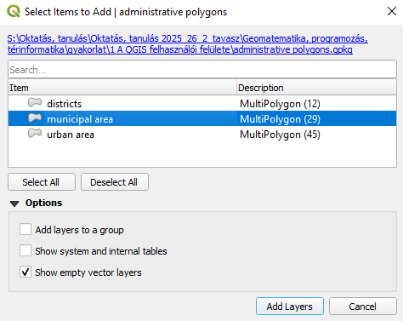
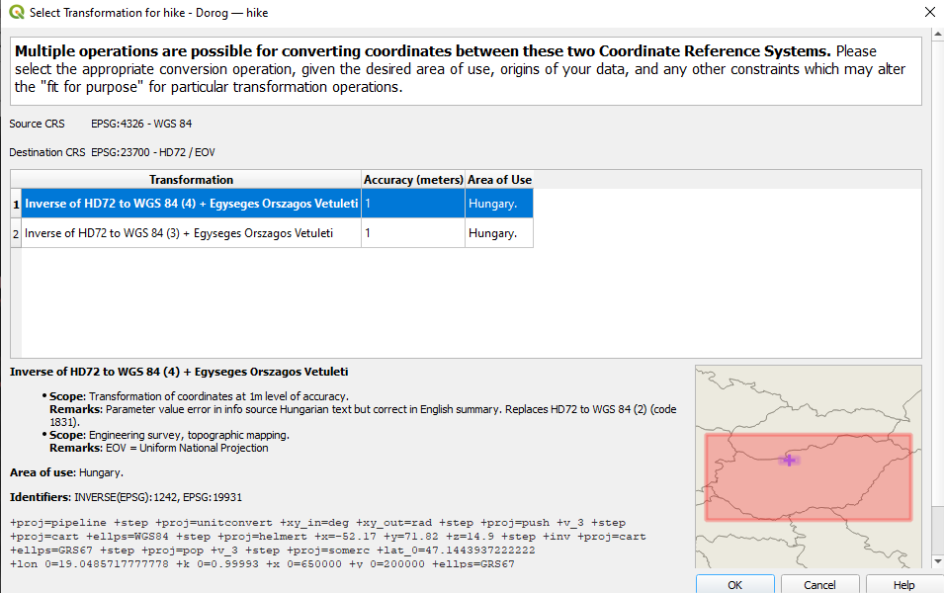
Adding layers – vector
DEMO
  administrative polygons.gpkg: drag-and-drop, then select the layer "municipal area"
  hide it
  hike - Dorog.kml: add it, select its only one layer (of type LineString)
  coordinate reference system of the layer and the project differs → press OK in the popup window

Slide 21
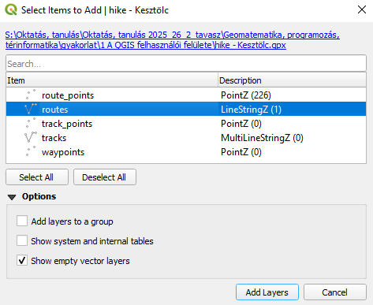
Adding layers – vector
DEMO
  hike - Kesztölc.gpx: add, select LineStringZ layer containing one element

Slide 22
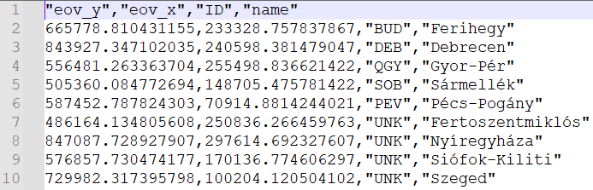
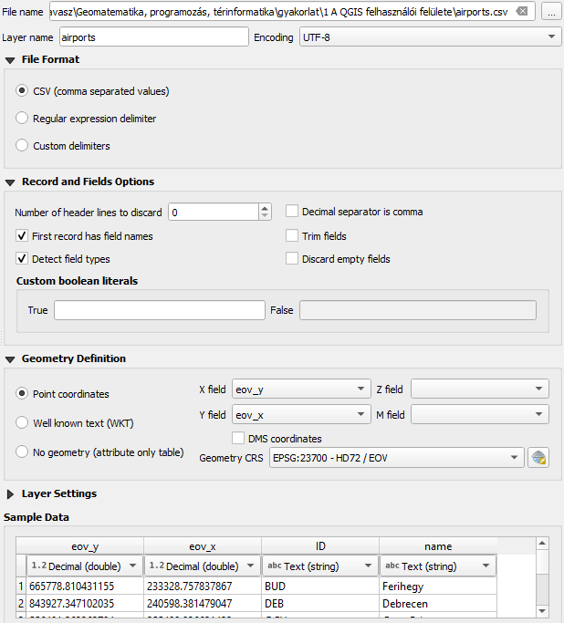
Adding layers – vector from non-spatial dataset
creating/adding vector layer from non-spatial dataset
  Layer > Add Layer > Add Delimited Text Layer…
DEMO
  open airports.csv in a text editor
  add it from the menu
  pay attention to the following: encoding, file format: CSV, header row, decimal, point coordinates, coordinate columns (order!), coordinate system
  zoom to the layer (right-click in the layer manager > Zoom to Layer(s)
Notes:
Réteg > Réteg hozzáadása > Tagolt szöveg réteg hozzáadása…
kódolás, CSV (vesszővel tagolt értékek), fejlécsor, pont koordináták, koordinátaoszlopok (sorrend!), koordináta-rendszer
jobb klikk a rétegkezelőben > Nagyítás a réteg(ek)re

Slide 23
Adding layers – vector from non-spatial dataset
creating/adding vector layer from non-spatial dataset
  Layer > Add Layer > Add Delimited Text Layer…
DEMO
  open airports.csv in a text editor
  add it from the menu
  pay attention to the following: encoding, file format: CSV, header row, decimal, point coordinates, coordinate columns (order!), coordinate system
  zoom to the layer (right-click in the layer manager > Zoom to Layer(s)
0
Notes:
Réteg > Réteg hozzáadása > Tagolt szöveg réteg hozzáadása…
kódolás, CSV (vesszővel tagolt értékek), fejlécsor, pont koordináták, koordinátaoszlopok (sorrend!), koordináta-rendszer
jobb klikk a rétegkezelőben > Nagyítás a réteg(ek)re

Slide 24
Adding layers – non-spatial dataset as simple table
drag-and-drop (from Browser panel or other software)
or using the previous method, but select "No geometry (attribute only table)" instead of "Point coordinates"
DEMO
  drag-and-drop educational data.dbf and land cover categories.xlsx files
Notes:
"Pont koordináták" helyett "Nincs geometria (csak attribútumok)"

Slide 25
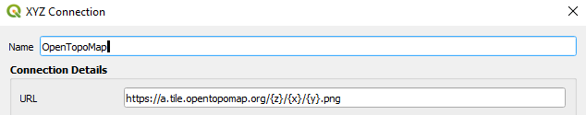
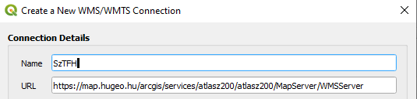
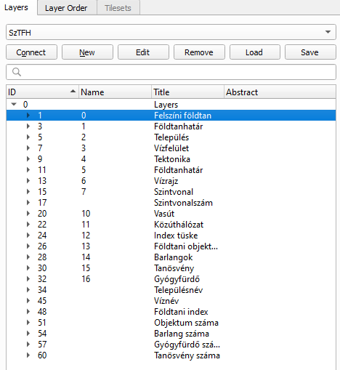
Adding layers – online service
adding online/server services
  Layer > Add Layer > Add XYZ Layer…
  Layer > Add Layer > Add WMS/WMTS Layer…
  New, OK, select, Add
DEMO
  XYZ, New, OpenTopoMap, https://a.tile.opentopomap.org/{z}/{x}/{y}.png
  move to the bottom of the layer manager
  WMS, New, SzTFH's geological WMS, https://map.hugeo.hu/arcgis/services/atlasz200/atlasz200/MapServer/WMSServer
  Connect, 0/"Felszíni földtan", Add
Notes:
Réteg > Réteg hozzáadása > XYZ réteg hozzáadása…
Réteg > Réteg hozzáadása > WMS/WMTS-réteg hozzáadása…
Új, OK,

Slide 26
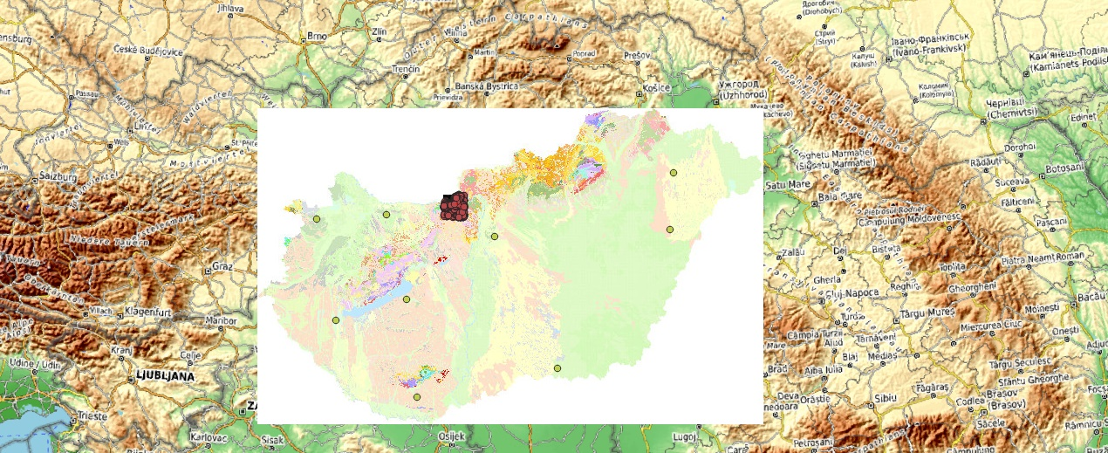
Adding layers – online service

Slide 27
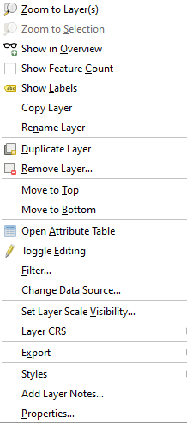
Managing layers
layer's visibility and order
group of layers
zoom to layer or layer group (right-click > Zoom to Layer(s)/Group)
rename (right-click > Rename Layer/Group)
delete (right-click > Remove Layer/Group)
  this only deletes the layer, not the file!
layer properties (right-click > Properties…)
attribute table (right-click > Open Attribute Table)
Notes:
jobb klikk > Nagyítás a réteg(ek)re/csoportra
jobb klikk > Réteg/Csoport átnevezése
jobb klikk > Réteg/Csoport eltávolítása
jobb klikk > Tulajdonságok…
jobb klikk > Attribútumtábla megnyitása

Slide 28
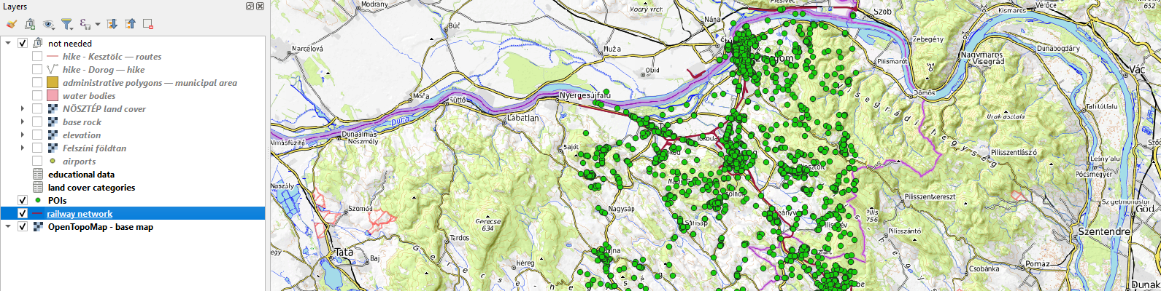
Managing layers
DEMO
  keep visible only these three layers: points of interest, railways, OpenTopoMap
  move the other layers to a new group called "not needed"
  rename the three layers
  zoom to the railway network

Slide 29
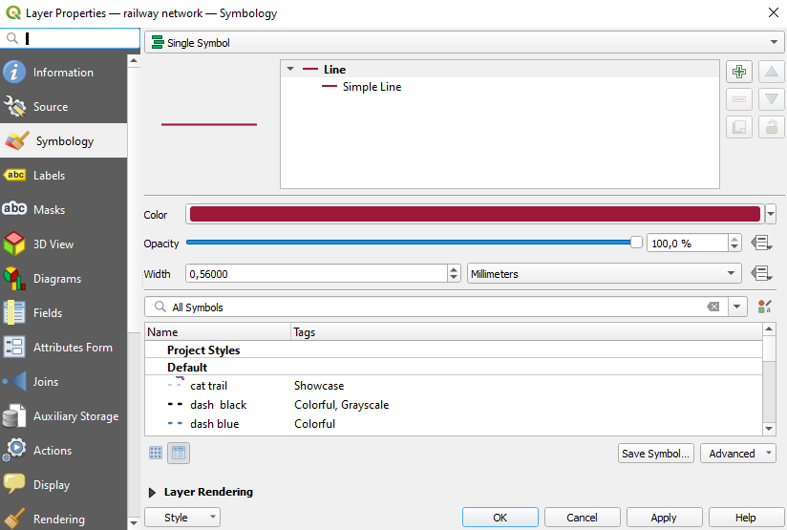
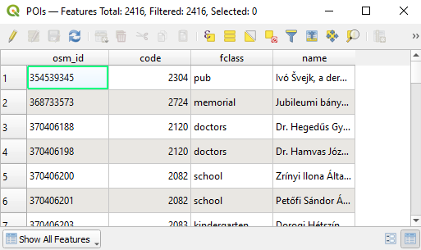
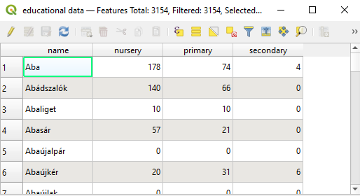
Managing layers
DEMO
  delete the airports layer
  check the properties (Information, Symbology) of railway network
  open the attribute table of POIs (spatial dataset)
  open the attribute table of educational data (non-spatial dataset)
Notes:
Információ, Jelrendszer

Slide 30
Managing layers
DEMO
  delete the airports layer
  check the properties (Information, Symbology) of railway network
  open the attribute table of POIs (spatial dataset)
  open the attribute table of educational data (non-spatial dataset)
– NEXT WEEK –
Notes:
Információ, Jelrendszer

Slide 31
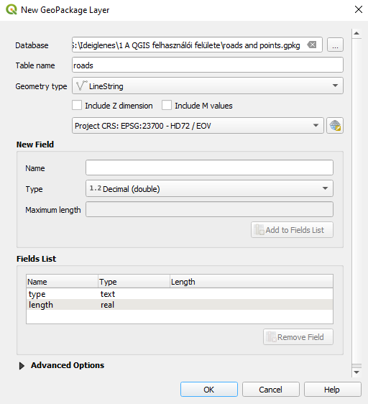
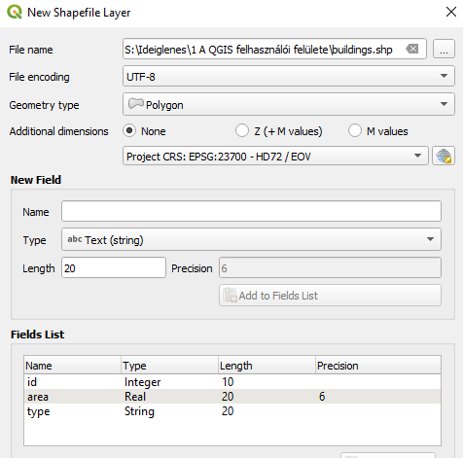
New vector layer
Layer > Create Layer >
  New GeoPackage Layer…
  New Shapefile Layer…
  etc.
properties
  path and name of the file
  layer name in the case of multi-layer format (e.g., .gpkg)
  encoding (e.g., UTF-8)
  geometry type
  coordinate reference system
  add fields (name, type, precision)
Notes:
Réteg > Réteg létrehozása >
Új GeoPackage-réteg…
Új shape fájl réteg…

Slide 32
New vector layer
Layer > Create Layer >
  New GeoPackage Layer…
  New Shapefile Layer…
  etc.
properties
  path and name of the file
  layer name in the case of multi-layer format (e.g., .gpkg)
  encoding (e.g., UTF-8)
  geometry type
  coordinate reference system
  add fields (name, type, precision)
Notes:
Réteg > Réteg létrehozása >
Új GeoPackage-réteg…
Új shape fájl réteg…

Slide 33
New vector layer
Layer > Create Layer >
  New GeoPackage Layer…
  New Shapefile Layer…
  etc.
properties
  path and name of the file
  layer name in the case of multi-layer format (e.g., .gpkg)
  encoding (e.g., UTF-8)
  geometry type
  coordinate reference system
  add fields (name, type, precision)
Notes:
Réteg > Réteg létrehozása >
Új GeoPackage-réteg…
Új shape fájl réteg…

Slide 34
New vector layer
Layer > Create Layer >
  New GeoPackage Layer…
  New Shapefile Layer…
  etc.
properties
  path and name of the file
  layer name in the case of multi-layer format (e.g., .gpkg)
  encoding (e.g., UTF-8)
  geometry type
  coordinate reference system
  add fields (name, type, precision)
Notes:
Réteg > Réteg létrehozása >
Új GeoPackage-réteg…
Új shape fájl réteg…

Slide 35
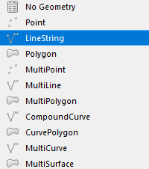
New vector layer
Layer > Create Layer >
  New GeoPackage Layer…
  New Shapefile Layer…
  etc.
properties
  path and name of the file
  layer name in the case of multi-layer format (e.g., .gpkg)
  encoding (e.g., UTF-8)
  geometry type
  coordinate reference system
  add fields (name, type, precision)
Notes:
Réteg > Réteg létrehozása >
Új GeoPackage-réteg…
Új shape fájl réteg…

Slide 36
New vector layer
Layer > Create Layer >
  New GeoPackage Layer…
  New Shapefile Layer…
  etc.
properties
  path and name of the file
  layer name in the case of multi-layer format (e.g., .gpkg)
  encoding (e.g., UTF-8)
  geometry type
  coordinate reference system
  add fields (name, type, precision)
Notes:
Réteg > Réteg létrehozása >
Új GeoPackage-réteg…
Új shape fájl réteg…

Slide 37
New vector layer
Layer > Create Layer >
  New GeoPackage Layer…
  New Shapefile Layer…
  etc.
properties
  path and name of the file
  layer name in the case of multi-layer format (e.g., .gpkg)
  encoding (e.g., UTF-8)
  geometry type
  coordinate reference system
  add fields (name, type, precision)
Notes:
Réteg > Réteg létrehozása >
Új GeoPackage-réteg…
Új shape fájl réteg…

Slide 38
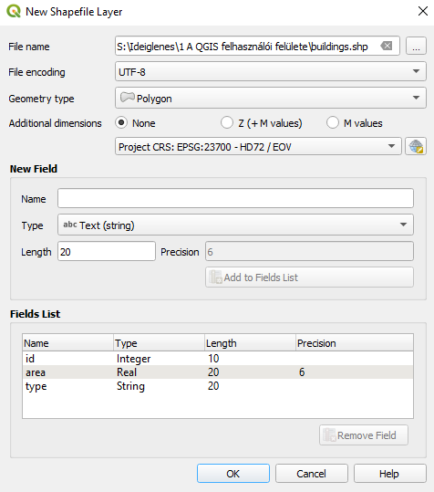
New vector layer
DEMO
  create a new shapefile called "buildings"
  polygon geometry, HD72/EOV projection
  contains a real and a text field

Slide 39
New vector layer
DEMO
  create a new GeoPackage file called "roads and points"
  including a layer called "roads"
  HD72/EOV projection
  this should contain a real and text field as well

Slide 40
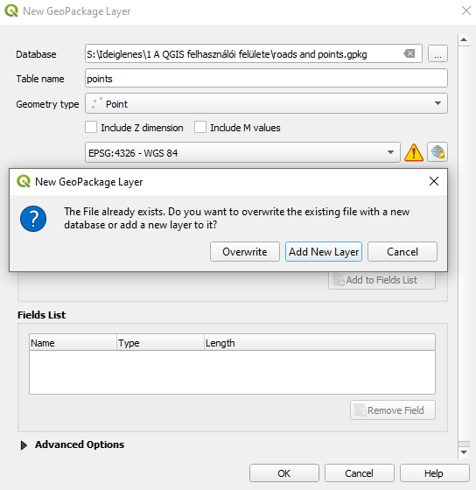
Appending new vector layer to existing file
in the case of multi-layer formats
we select an already existing file
and give a new name for the new layer
  can have different geometry type
  and different coordinate reference system
after OK, we might
  overwrite the existing file (with a new, single-layer file)
  or keep the existing file (and its layers) and append the new layer to it

Slide 41
Appending new vector layer to existing file
DEMO
  append a new, point-type layer to the already existing GeoPackage file
  using a different coordinate reference system (e.g., WGS-84)

Slide 42
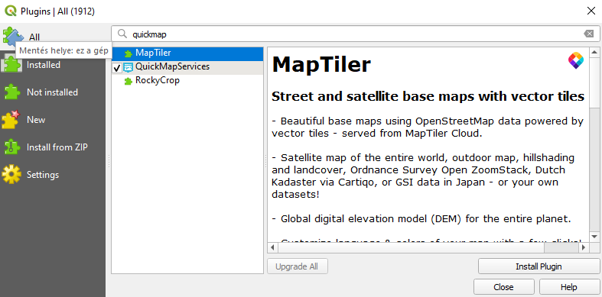
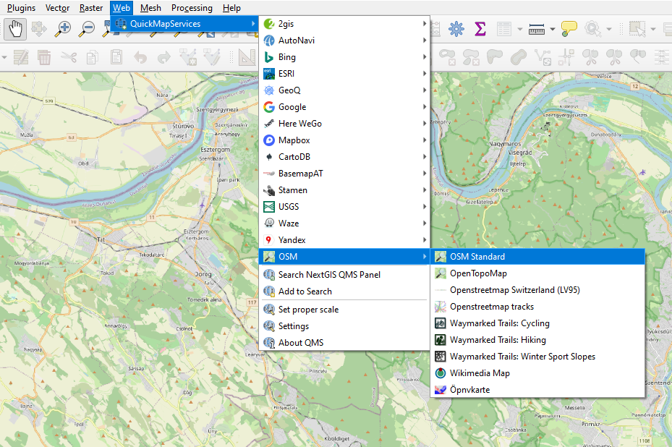
Plugins
functionality of QGIS can be expanded with
  tools (in the Processing toolbox) – simple scripts
  plugins/modules – serve to solve more complex tasks
installing plugins
  Plugins > Manage and Install Plugins… > All
  use the search box
  Install Plugin
DEMO
  install plugin QuickMapServices
  add the base map OSM Standard to the project
Notes:
Modulok > Modulok kezelése és telepítése… > Mind
Modul telepítése

Slide 43
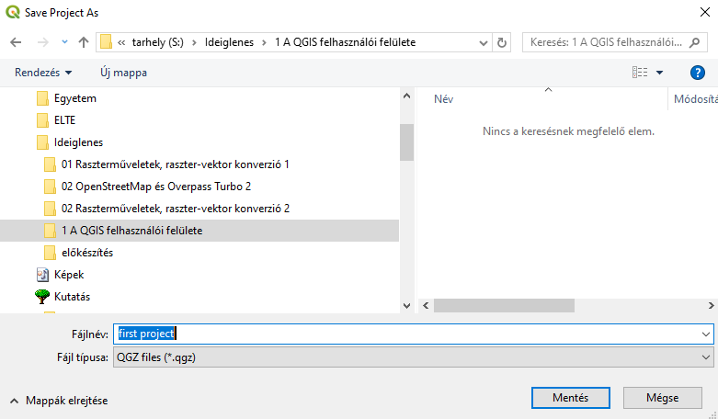
Saving project
the project can be saved in .qgs/.qgz formats
  Project > Save
  Project > Save As…
later can be opened by double-click
  or: Project > Open…
DEMO
  save the project
Notes:
Projekt > Mentés
Projekt > Mentés másként…
Projekt > Megnyitás…

Slide 44
Thank you for your attention!
questions?

